Slide 1



Weekly Progress: Embedding & RAG
On Development of an on-Premise AI Product Recommendation Model Using Open-Source LLM
Monir (248810)
25 March 2025
Department of Artificial Intelligence Convergence

Slide 2

Project Description
Project Title
Development of an on-Premise AI Product Recommendation Model Using Open-Source LLM
Company: Narosu Co. Ltd.
Project Description
The e-commerce market is becoming increasingly competitive, requiring advanced recommendation systems.
Large marketplaces use sophisticated AI models, but independent online store operators lack such solutions.
This project aims to develop an AI-powered product recommendation system tailored for self-managed online stores.
By analyzing customer preferences, the system will suggest products that align with their interests.
Project Objective
Develop an AI-based search and recommendation system that analyzes user input sentences and recommends the TOP 5 most relevant products based on semantic similarity.
Utilize Natural Language Processing (NLP) and vector search technology to provide a highly refined search experience.
Deploy in an on-premise environment to ensure data privacy and full control over the recommendation process.
1

Slide 3
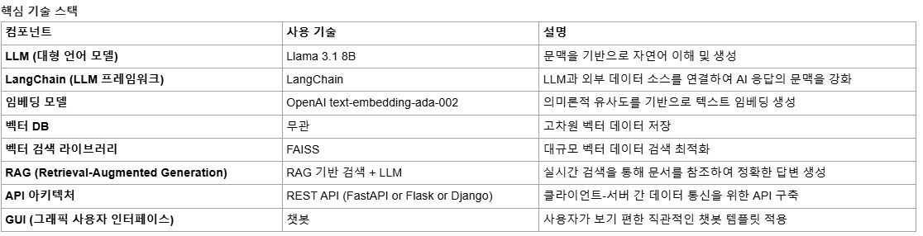
Company Requirements
OpenAI text-embedding-ada-002 is a paid model
Try with free models such as:
Sentence Transformers (all-MiniLM-L6-v2)
Hugging Face Transformers (intfloat/e5-small-v2)
2

Slide 4
Project Schedule (Gantt Chart)
Phase | 2025
 | March |  |  |  | April |  |  |  | May |  |  |  | June
 | 1 | 2 | 3 | 4 | 1 | 2 | 3 | 4 | 1 | 2 | 3 | 4 | 1 | 2
Project Understanding and Data Collection
Data Analysis and Pre-processing
AI Model Selection and Training
System Development
Chatbot UI Development
Testing and Deployment
3

Slide 5
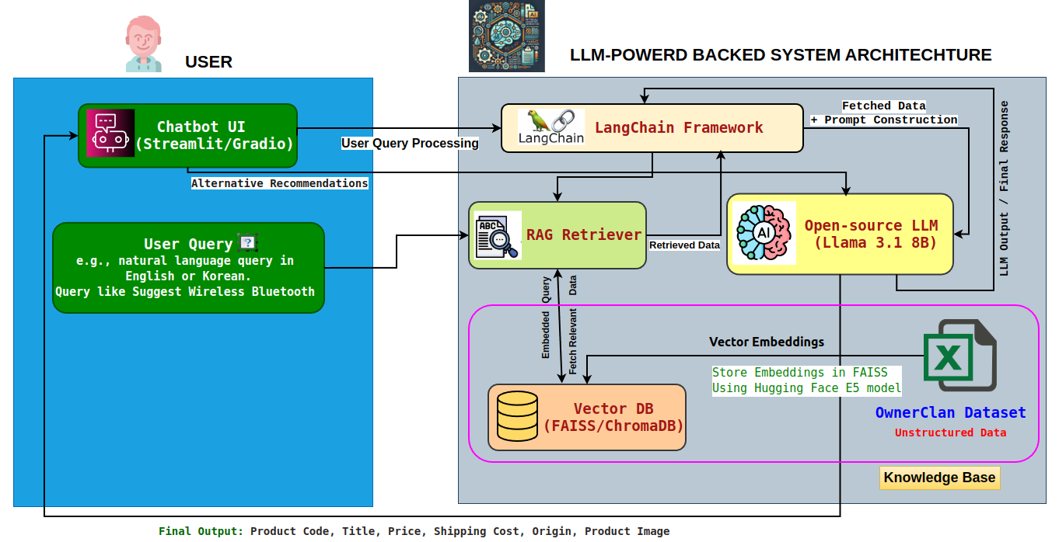
System Configuration (AI Model) Diagram
4

Slide 6
Communication with company
Questions:
Does the recommendation system need to support multilingual responses (Korean, English, Japanese), etc.? Or is there a language you prefer?
What are the key metrics to evaluate the performance of a recommendation model?
If a customer rejects the first set of recommendations, does the Chatbot have to offer an alternate recommendation?
Contents of the answer
The dataset is fixed in Korean, but it must be multilingual. Responses must be submitted in a language supported by your Llama model (Priority: Korean, English)
F1 Score 를 제외한: If there is a noteworthy evaluation index in AI evaluation similar to product recommendation, please present it. I would appreciate it if you could write a brief explanation of the indicator and the reason why you selected the indicator.
Alternative recommendation is required . Promptly, send your students their thoughts on what questions they would ask to find information about their preferred products. ( vector update questions, vector orientation questions, vector adjustment questions, etc.)
5

Slide 7
Communication with company (Cont.)
Questions:
Does the recommender system need to support multilingual responses (English, Japanese, Korean), etc.? Or is there a language you prefer?
Are datasets updated regularly? If so, how often will new products be added?
Contents of the answer
The dataset is fixed in Korean, but it must be multilingual. When entering a sentence in Korean, the recommendation and answer must be given in Korean, and if the sentence input is a foreign language such as English or Thai , the answer must be submitted in the appropriate language of each language.
In the AI convergence project, the secondary dataset is final. but, Our company's ultimate goal is to update products regularly like tie commerce . Therefore, by subdividing the goals, the first goal is 4 million data, and the second and final goals are 4 million data considering the updating(updating) of the product. We would appreciate it if you could share your ideas on how to update and update the RAG-based chatbot easily, quickly, and conveniently.
6

Slide 8
Communication with company (Cont.)
Questions:
What are the key metrics to evaluate the performance of a recommendation model?
If a customer rejects the first set of recommendations, does the chatbot have to offer an alternate recommendation?
Can I use a paid embedding model (OpenAI's GPT)?
Contents of the answer
Based on F1 Score. Based on the precision and recall of the AI recommendation system, we evaluate whether the AI recommendation is practical.
Alternative recommendation is required. The goal is to allow you to proceed to checkout with only the chatbot's recommendation without looking at the product list, so if you reject the first set of recommendations, you need to ask additional questions or suggest recommendations in a different direction.
You can change to OpenAI's paid embedding model. (Please note that Narosu does not support subsidies.)
7

Slide 9
Communication with company
There is additional sharing content, so we will write it together .
When sharing the secondary dataset , the contents of the column list of the existing Excel file will be organized and shared. Please proceed with the chatbot development based on the Excel file.
https://revf.tistory.com/303 (AI 오픈소스 정리본).
We will send you a well-organized link, so we will organize the frameworks that students will use and tell us.

Slide 10
Embeddings in our system (OwnerClan Dataset)
🔍 What are Embeddings?
Embeddings are numerical representations of text data.
Similar meanings produce similar vector representations.
Example: "블루투스 이어폰" and "Bluetooth earphone" → close in vector space.
📦 How Embeddings Work
Input: Product title + keywords + specs → combined text
Model: Free E5 model generates vector embeddings
Storage: Vectors stored in FAISS (vector DB)
Search: User query → embedded → matched with product vectors
Product Info (Title + Keywords + Specs)
User Query (KR/EN)
Preprocessed into
Single Text
Query Embedding via E5 Model
Hugging Face E5 Model
(Generate Embeddings)
FAISS Similarity Search
Store Embeddings in
FAISS (Vector DB)
Top-K Matching Products
Need to usability check of FAISS in my project!
9

Slide 11
Example of Embeddings Output in our system
Original Query (KR): 게이밍 블루투스 헤드셋
Translated Query (EN): Gaming Bluetooth Headset
원본상품명 키워드 카테고리명 Product Name (EN) Keywords (EN) Category (EN)
6953 맥스틸 올인원 게이밍 블루투스헤드셋,무선헤드셋, led헤드셋,올인원헤드셋,
헤드셋 GM-GHC300 헤드셋, 유선헤드셋,게이밍헤드셋 삼... 디지털/가전>멀티
미디어장비>PC헤드셋
Max Steel All-in-One Gaming Bluetooth headset, wireless headset Digital/Home Appliances>
Headset GM-GHC300 Headset Multimedia Equipment
Problem of embedding model, "all-MiniLM-L6-v2" does not support multiple languages.
Query output from FAISS sometimes provides incorrect results."
10

Slide 12
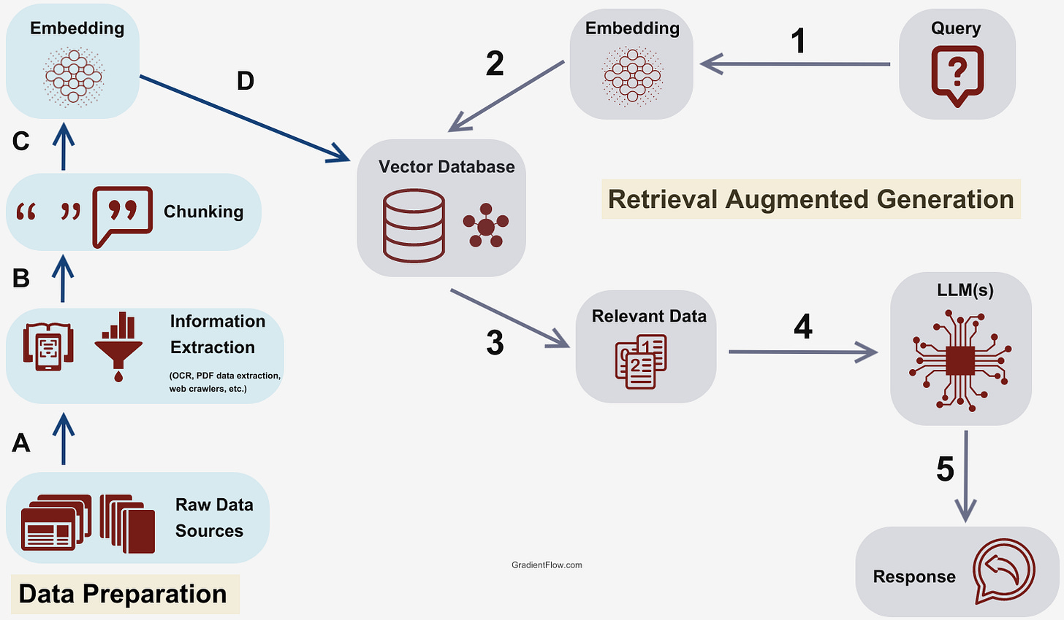
Retrieval-Augmented Generation (RAG) Study
🔄 What is RAG?
Combines retrieval and generation.
RAG retrieves relevant product info and passes it to an LLM (like LLaMA 3) to generate context-aware responses.
Useful when dealing with large product databases or vague queries.
⚙️ RAG Pipeline in this Project
User Query: Given in English or Korean (e.g., “남자용 데일리 백팩 추천”).
Embedding: The query is embedded using the same E5 model.
Retrieval (FAISS): Top-k most similar product entries are retrieved.
LLM + LangChain: Retrieved data is sent to LLaMA 3 with a crafted prompt.
Final Output: A personalized product suggestion or alternative recommendation.
11

Slide 13
Next Tasks To Do
Next Step
Vector Database model selection for usability and scalability.
Text Embedding model selection for multiple languages such as Korean, English, and Chinese.
Test the models based on the OwnerClan dataset.
12

Slide 14
Thank You for Listening
13

